Slide 1
An FPGA implementation of Vision Algorithms using Xilinx System Generator
Presented by
K. Koushik
Roll no:620144, Batch no:EC3M26
Mentor
Dr. Puli Kishore Kumar
Asst Professor , ECE Dept.
NIT ANDHRA PRADESH

Slide 2
ABSTRACT
In this project we are going to develop the state of art for mapping signal processing algorithms to the FPGA architecture.­ ­We will be using Xilinx System Generator as a platform for our work. We will design required circuitry blocks using Xilinx System Generator which will be targeted onto FPGA board i,e ZYNQ ZC706 through hardware Co-Simulation using JTAG to see the final result. We also have to explore logic debugging features which helps us to debug while design is running in hardware.

Slide 3
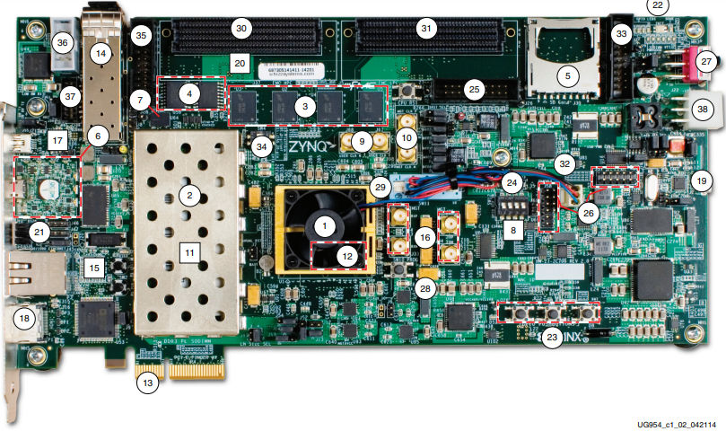
Zynq-ZC706 Evolutionary board

Slide 4
Zynq-ZC706 Evolutionary board
The Zynq-ZC706 evaluation board provides a hardware environment for developing and evaluating designs. Provides features common to many embedded processing systems like DDR3 SODIMM RAM, component memory, Ethernet PHY, general purpose I/O, two UART interfaces and many more.

Slide 5
Xilinx System Generator
Xilinx System Generator for DSP (SysGen) is a MATLAB Simulink add-on that enables the development of architecture-level FPGA designs using graphical blocks programming.
System Generator provides hardware co-simulation, making it possible to incorporate a design running in an FPGA directly into a Simulink simulation.
Xilinx blocks and Simulink blocks are used together for full architecture design.

Slide 6
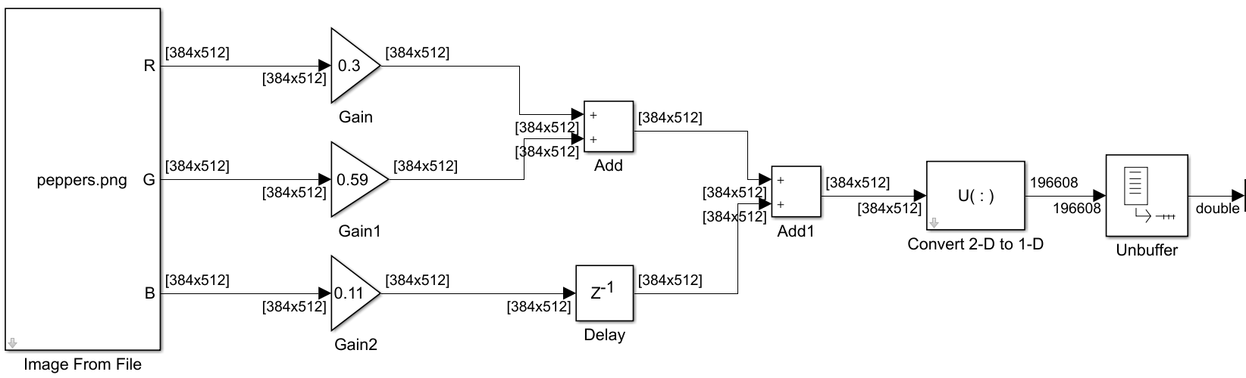
Image pre-processing subsystem.
This subsystem is used to convert RGB image to Gray scale image. Then image data will be converted from Matrix structure to array structure and is propagated to processing algorithm .

Slide 7
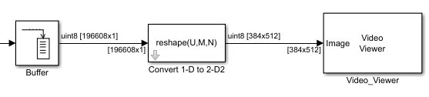
Image post-processing subsytem.
This subsystem is used after our main processing algorithm has been executed. This block converts data from array structure to matrix structure and will outputted. Processing Algorithm will be designed between pre-processing and post-processing subsystems.

Slide 8
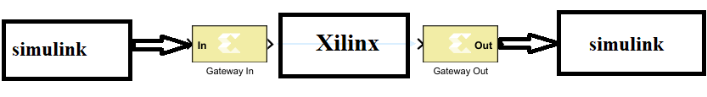
Dataflow
Simulink environment is used for pre-processing and post-processing subsystems. Main processing algorithm will be designed using Xilinx environment. “Gateway-in” and “Gateway-out” blocks are used for datatype conversion between these two environments. Datatype used to represent one pixel here is 8bit unsigned integer.

Slide 9
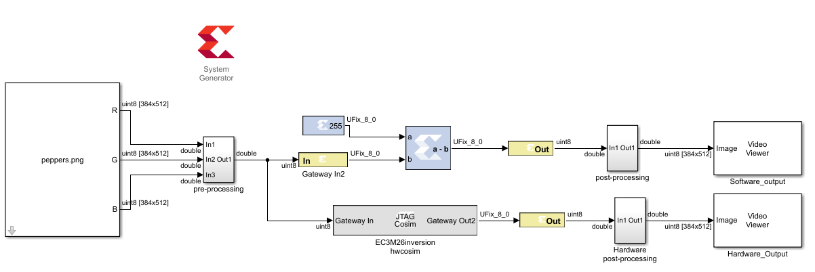

1.Image Negative output_pixel = 255$−$input_pixel.

Slide 10
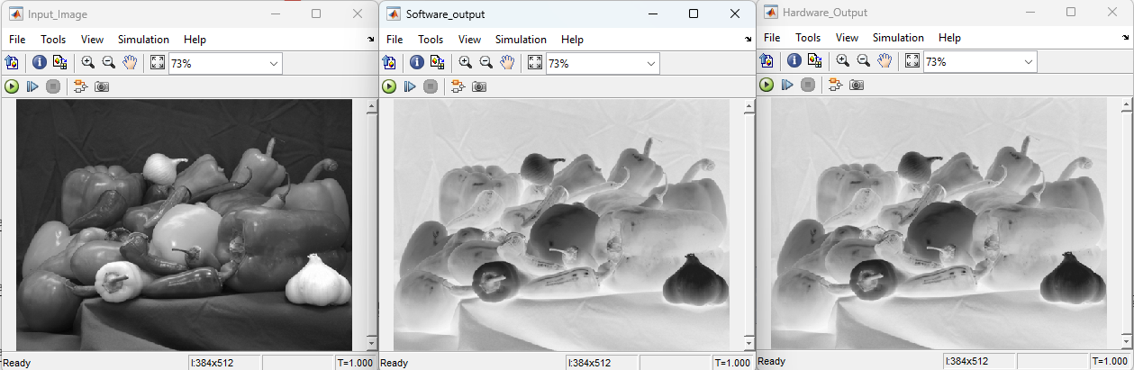
Results

Slide 11
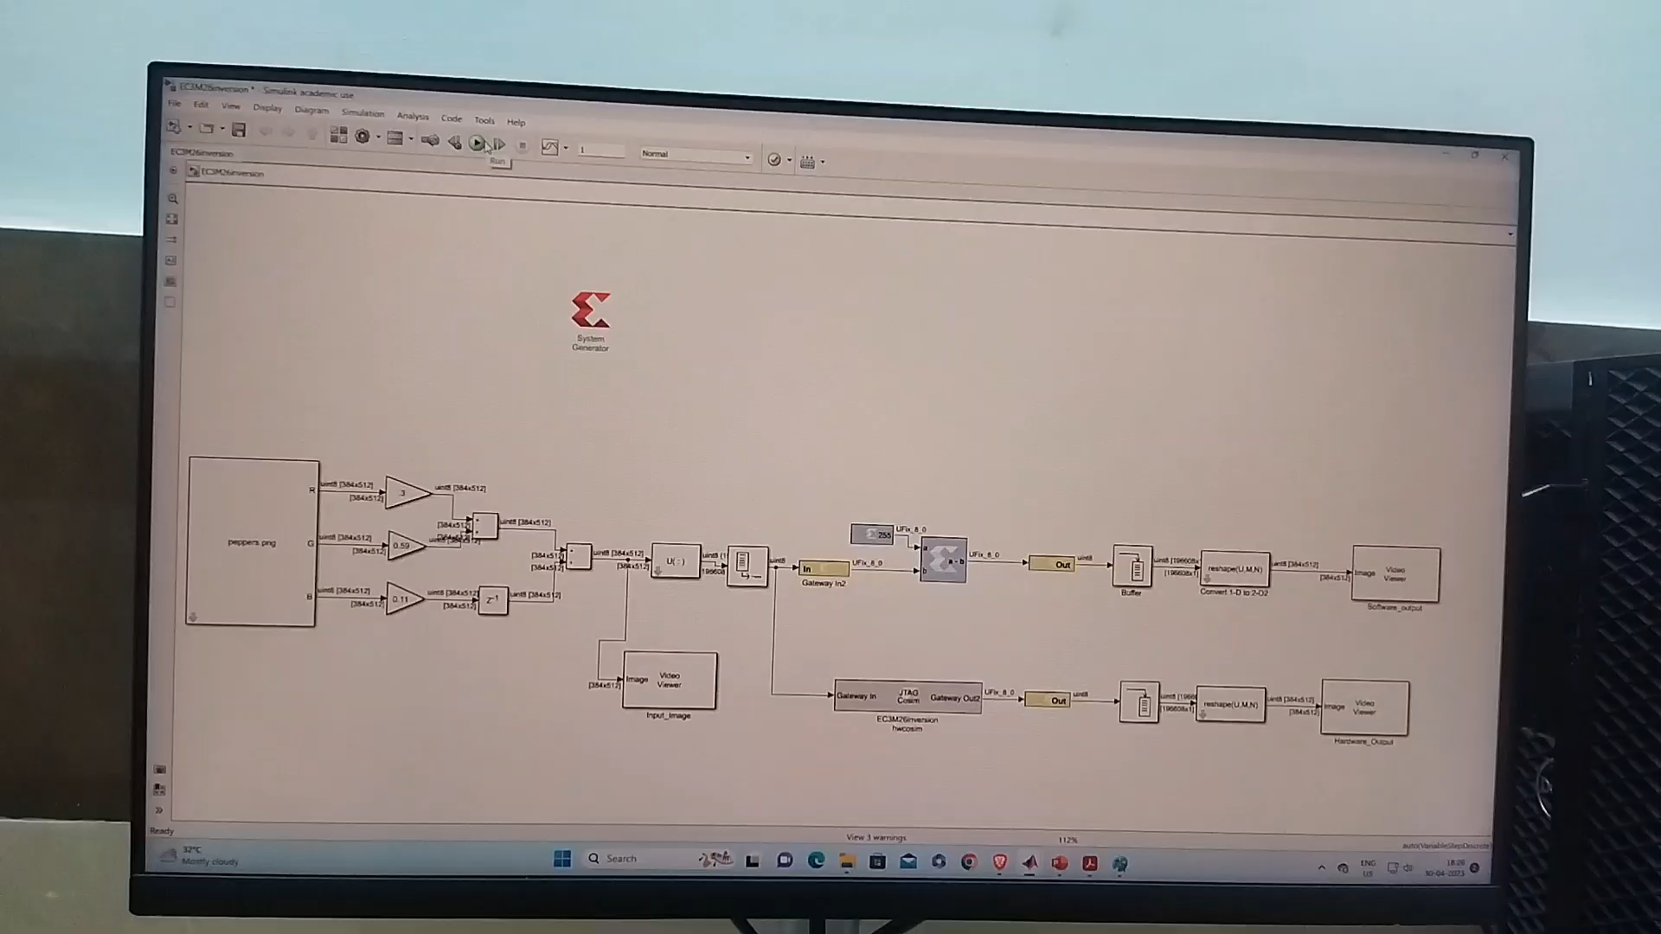
Execution

Slide 12
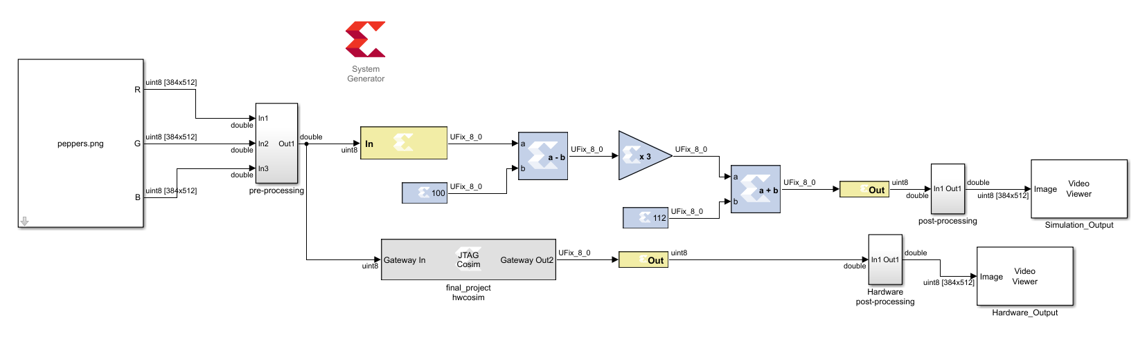

2)Image contrast stretching output_pixel = (input_pixel$−100$)$×$3 $+35.$

Slide 13
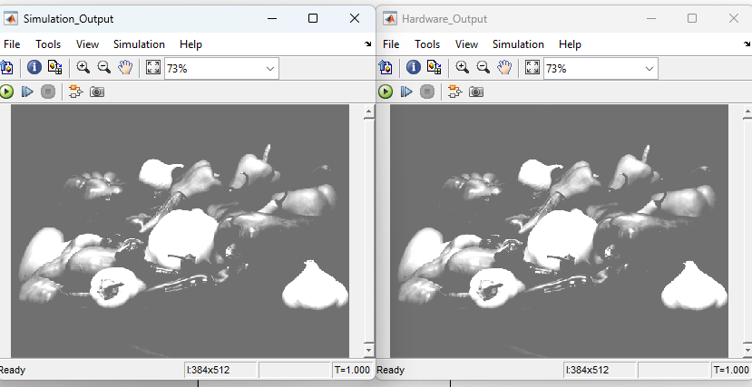
Results

Slide 14
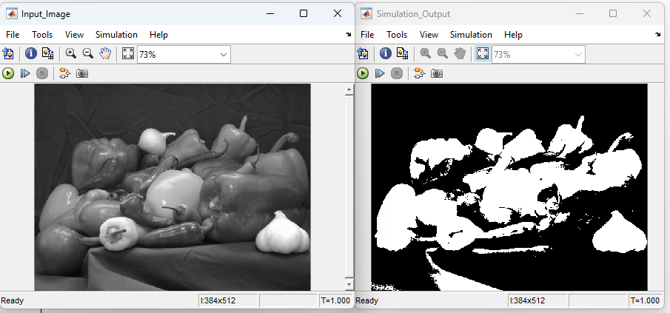

3)Image Threshold output_pixel$=$ 255 if input_pixel $≥$ threshold 0 Otherwise

Slide 15
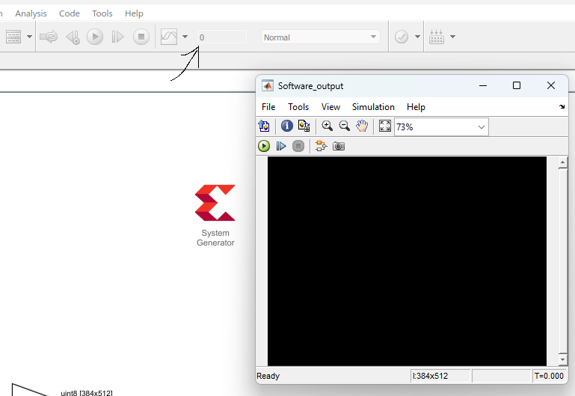
Challenges and Trouble Shooting
Similarly we can implement other vision processing architectures but one of the main aspect of this project is to tackle issues during designing and hardware implementation.
1) No Output : Number of time periods should be equal to or greater than the number of delays in the critical path.

Slide 16
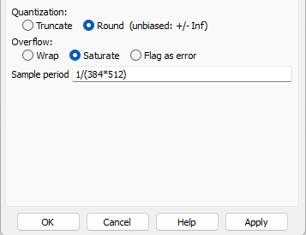
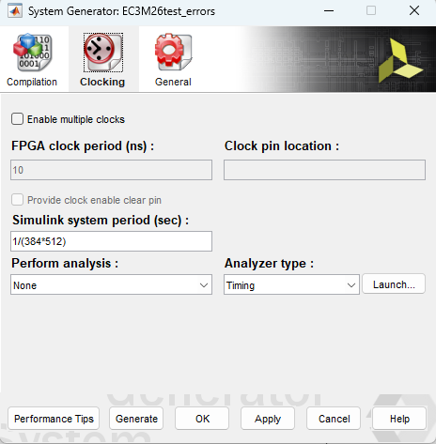
2)No Proper output : We need to set up sampling period equal to 1/(image size) in gateway and Xilinx system generator blocks. Otherwise it will take less sample and gives improper output.

Slide 17
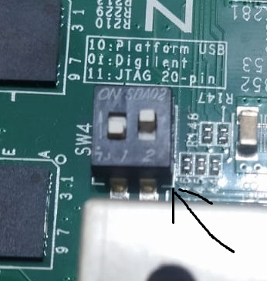
3)Hardware Connection : Hardware board will be connected through JTAG communication protocol. Thus, we need to setup DIP switch SW4 setting 01. Otherwise our board wont be detected by the system for hardware Co-Simulation.

Slide 18
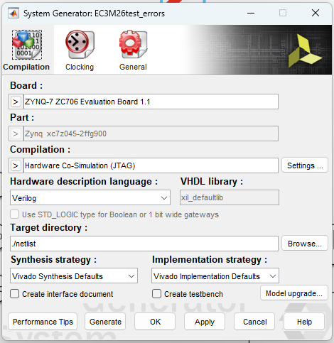


4)Hardware setup : During Generating bitstream we need to select our target board from the System Generator i.e. ZYNQ ZC-706 evaluation board 1.1 . For compilation we need to select Hardware Co-Simulation (JTAG).

Slide 19
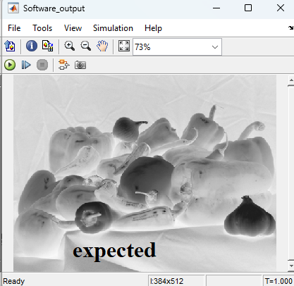
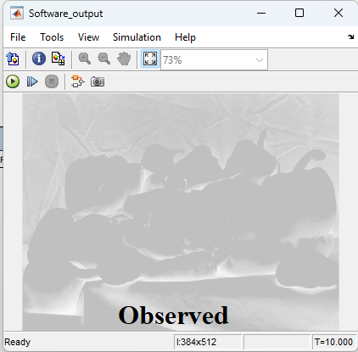
5) Datatype consistency : all blocks must have same datatype otherwise result might be distorted from the expected result . Below example shows that in gateway-in block datatype is defined a unsigned 6 bit while in other blocks it is unsigned 8 bit.

Slide 20
Conclusion
Thus we can develop any application specific algorithm using Xilinx System Generator and deploy them on the Hardware board. Here we need to use XSG as mediator for application which requires a desktop setup and tools which will eventually increase the cost and also computation time. So ,we are looking to cutoff this tools and setup and ultimately make a module which will be application specific.

